Slide 1
Introducing

Slide 2
The Illinois Attorney General’s Office
Charitable Trust Bureau
Online Filing System

Slide 3
An easy, secure way for charitable organizations to fulfill their filing requirements in compliance with Illinois law:
System-guided forms • Make requests for extension of time
Check status of AG filing/review • Check organization status
Online signatures • Generate Letters of Good Standing
Online payment • Correspondence by email

Slide 4
Who can file?

Slide 5
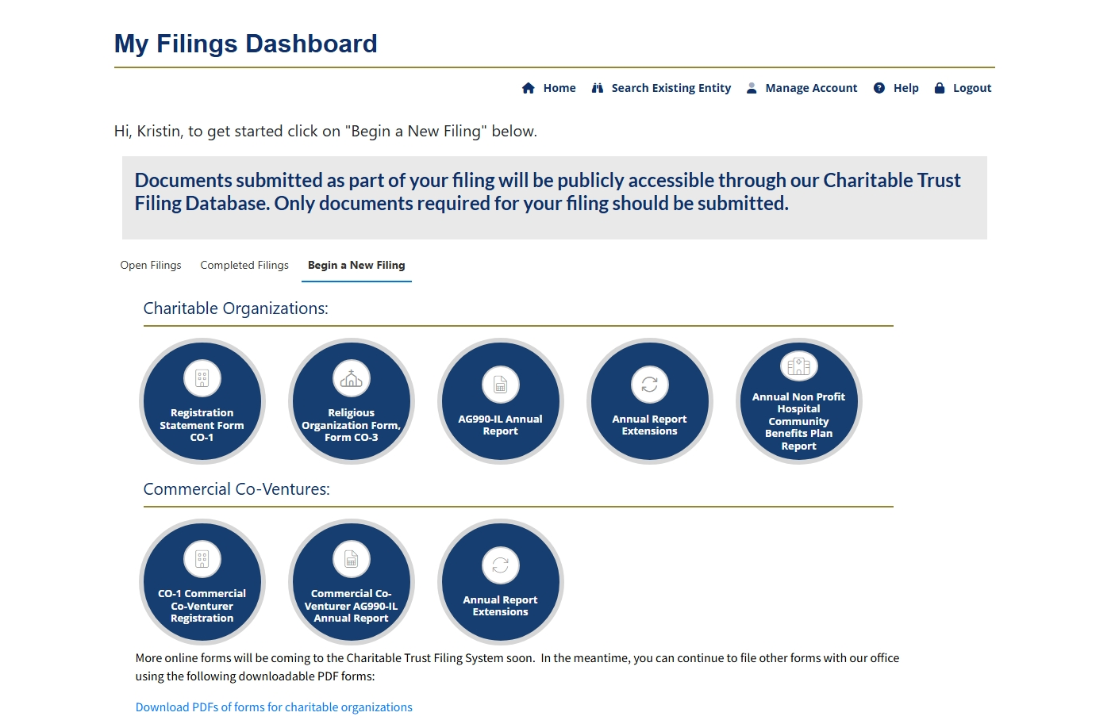

Slide 6
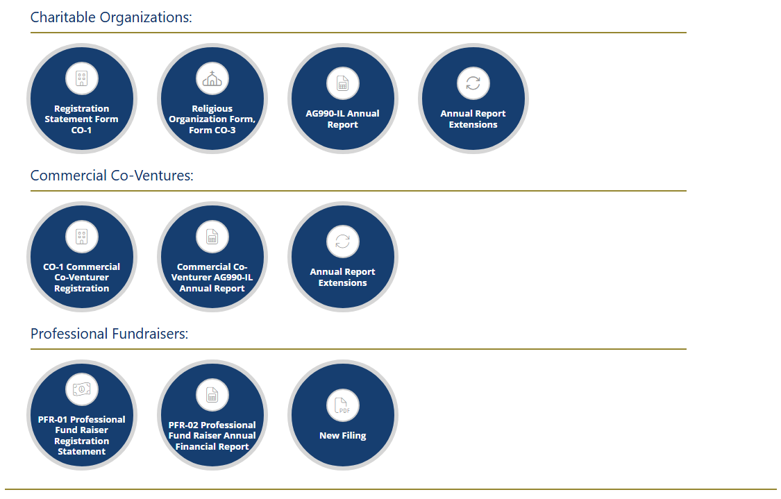

Coming Soon

Slide 7
Where to Start?

Slide 8
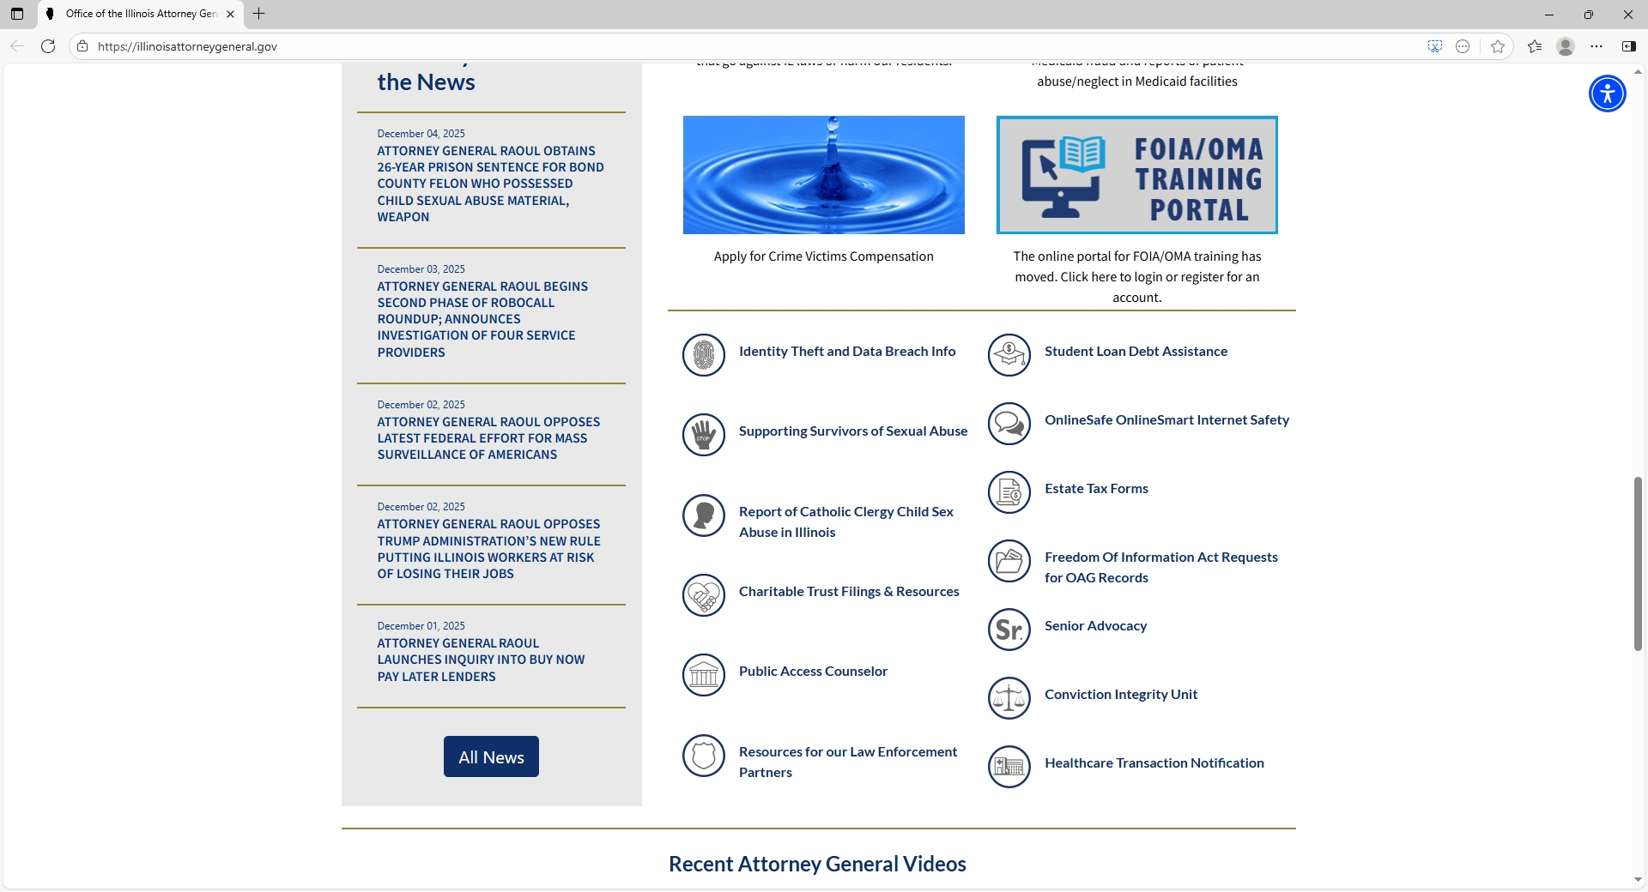
STEP 1: Go to the Attorney General’s Website: www.illinoisattorneygeneral.gov
STEP 2: Click “Charitable Trust Filings & Resources”

Slide 9
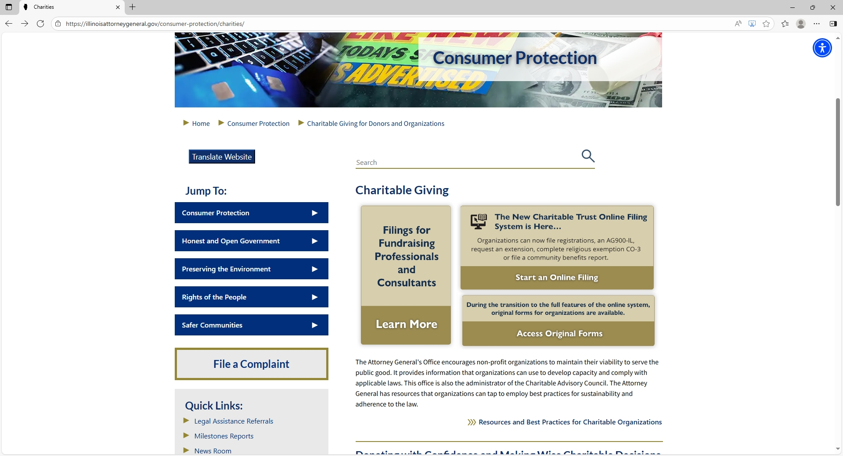
STEP 3: Click “Start an Online Filing” to Enter the Portal!

Slide 10
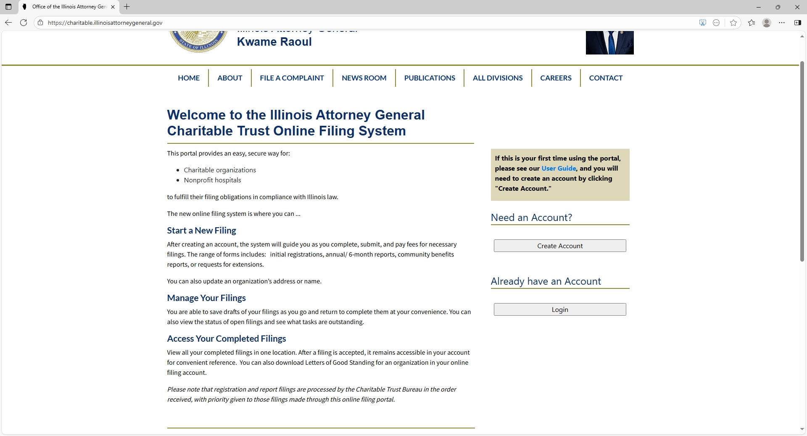

Slide 11
Create an Account

Slide 12
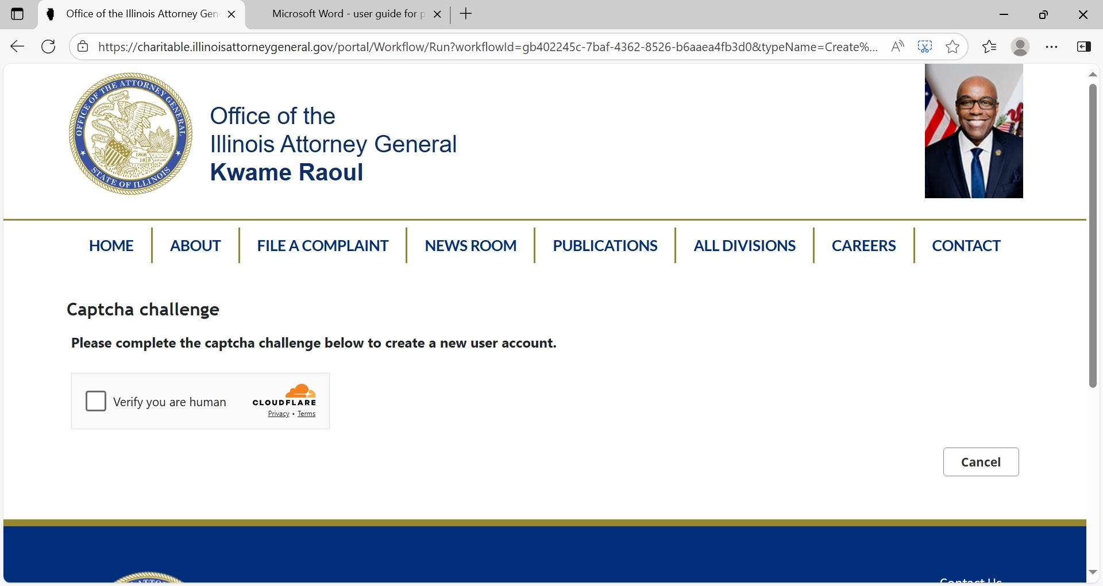
Creating an account

Slide 13
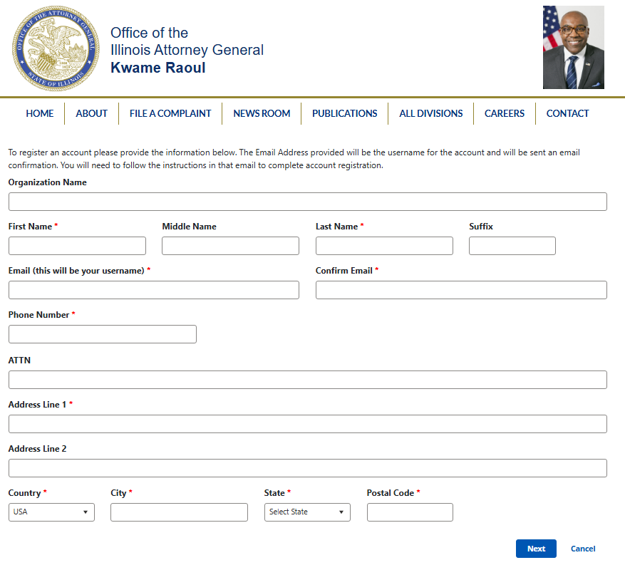

Slide 14
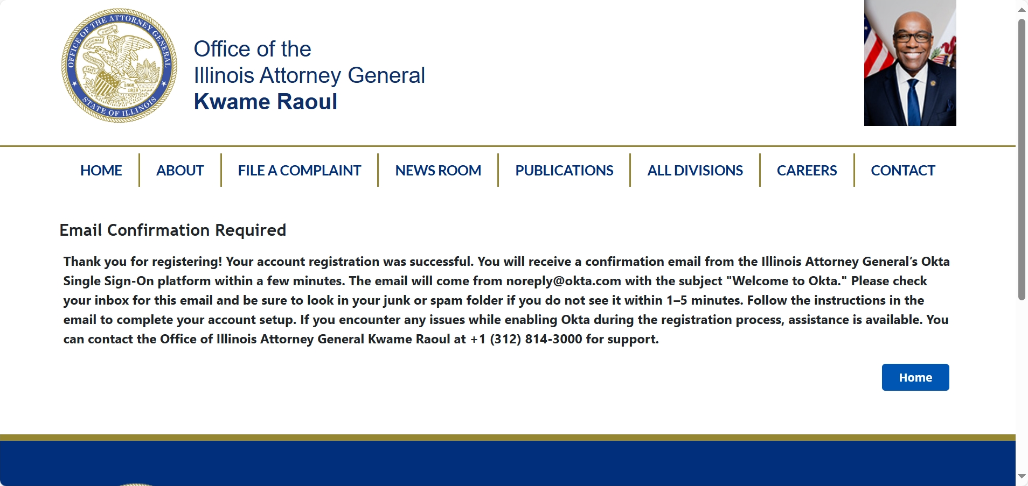
Creating an account
Notes:
For detailed instructions about enabling Okta please see our User Guide. Also, note that Okta does not require downloading the App. Can verify by text message.

Slide 15
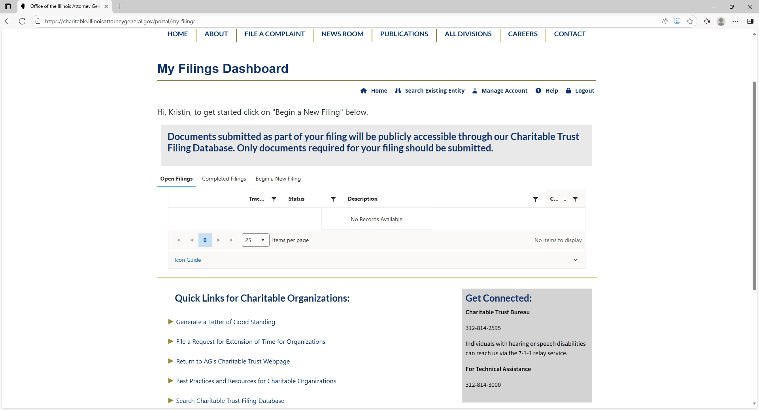
Begin a New Initial Registration

Slide 16
Begin a New Initial Registration

Slide 17
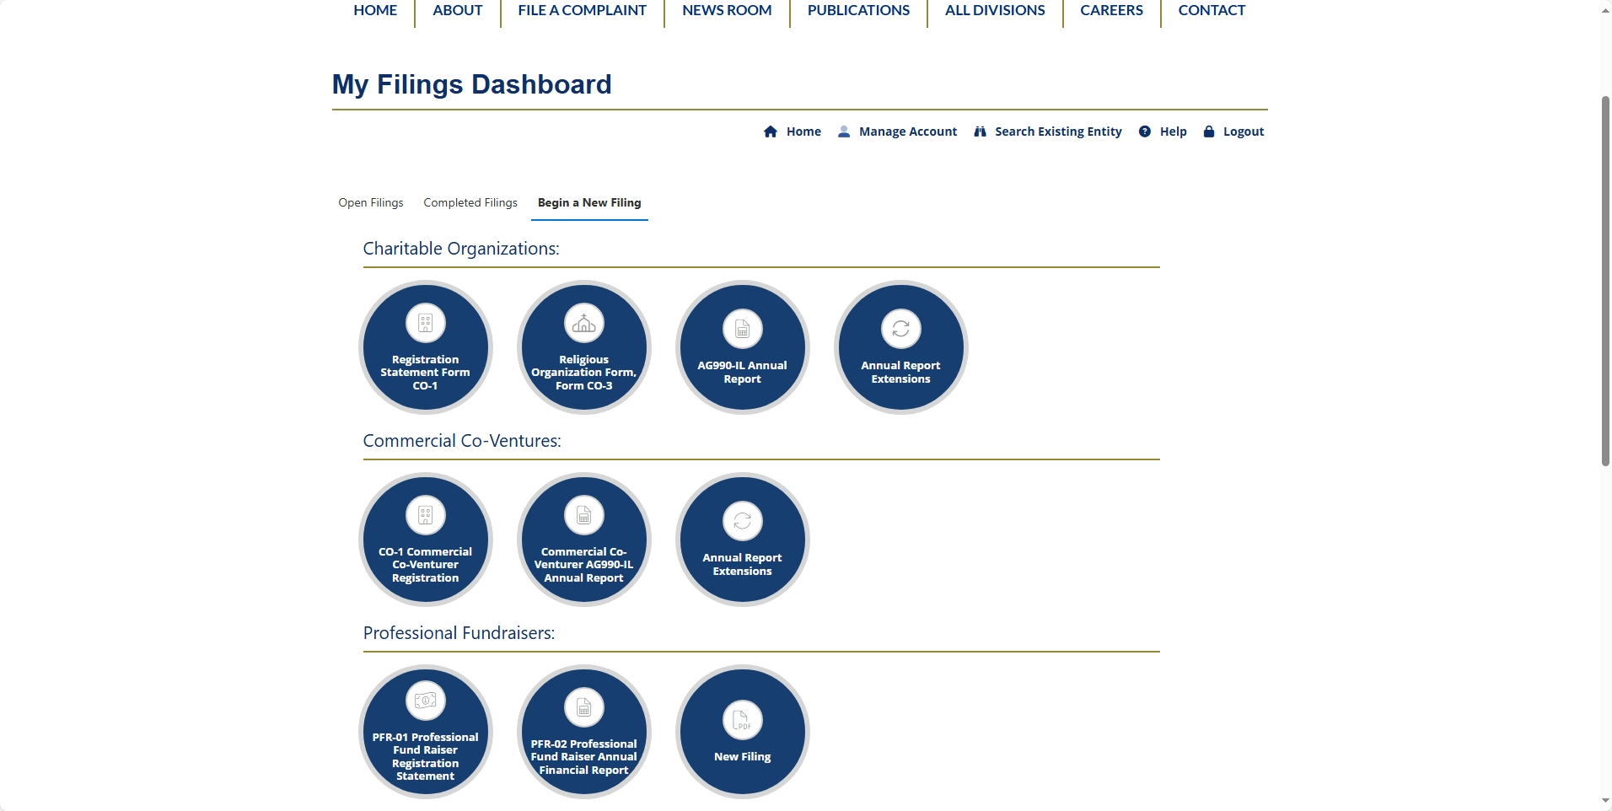

Slide 18
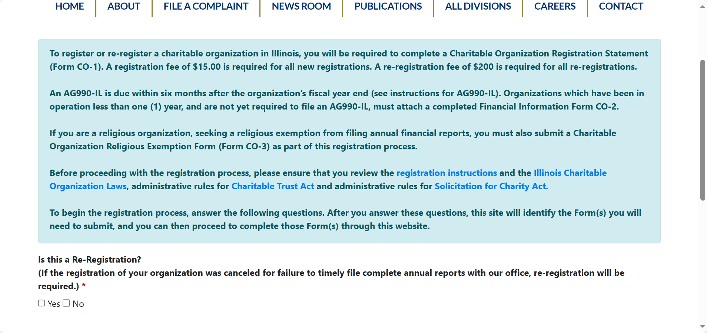

Slide 19
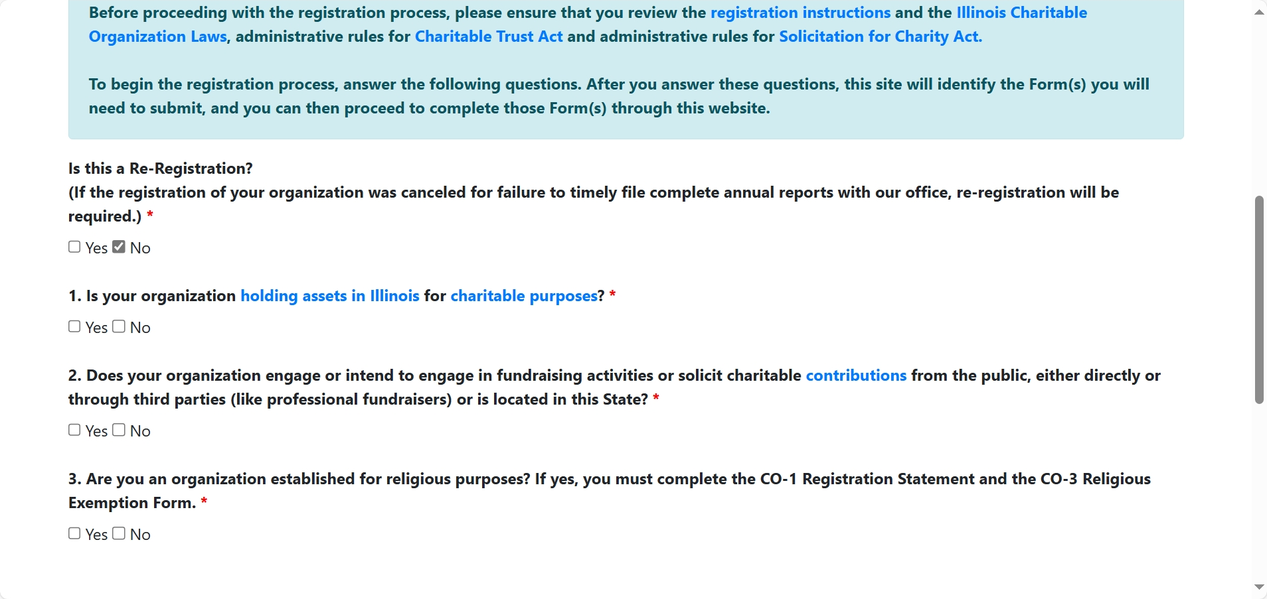

Slide 20
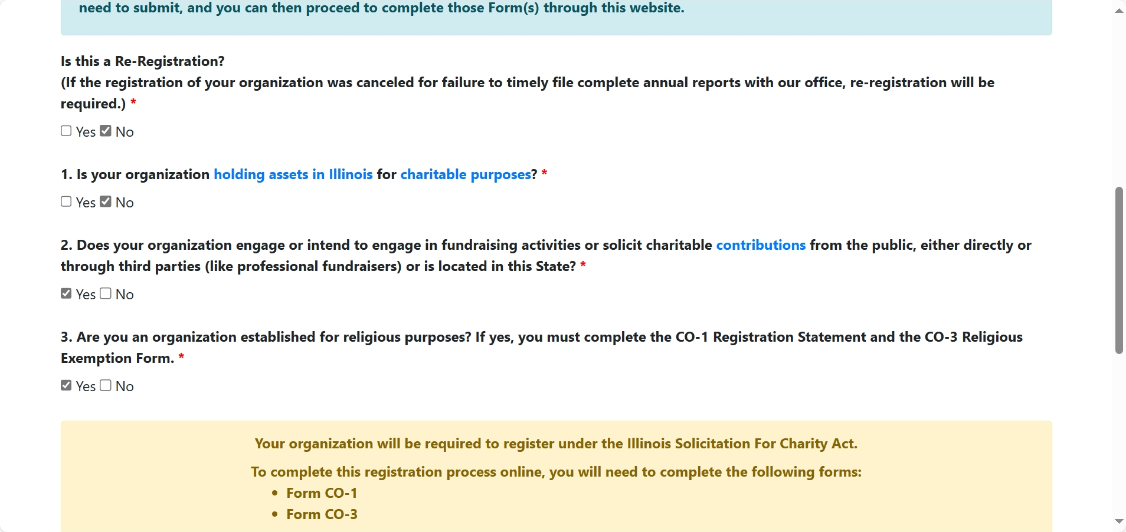

Slide 21
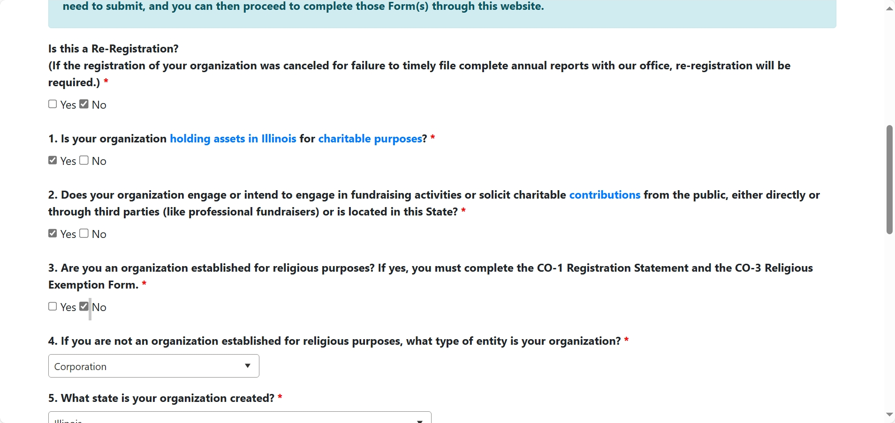

Slide 22
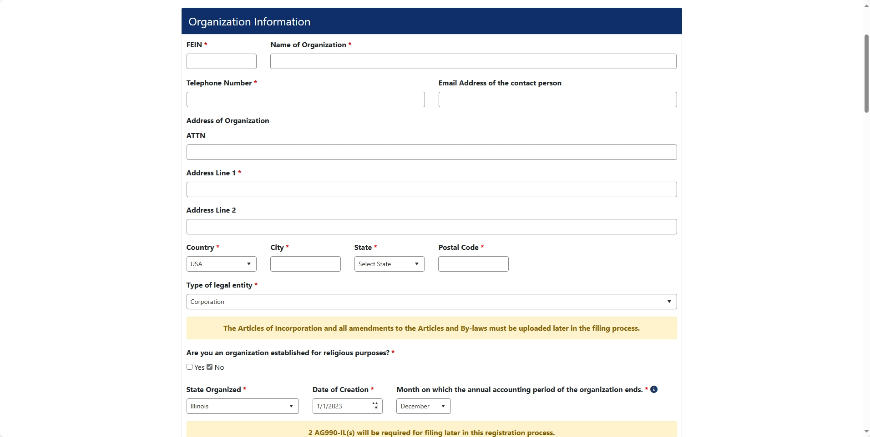

Slide 23
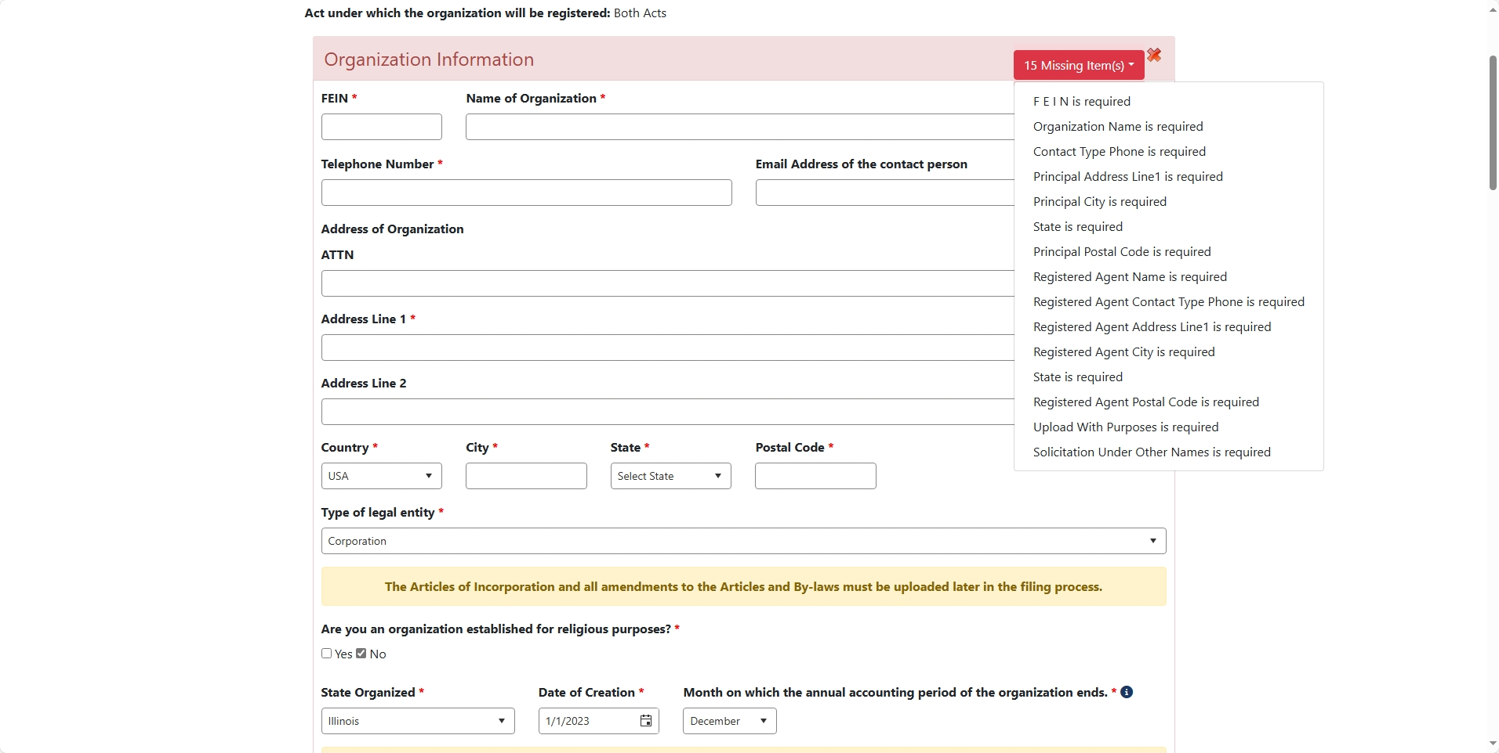

Slide 24
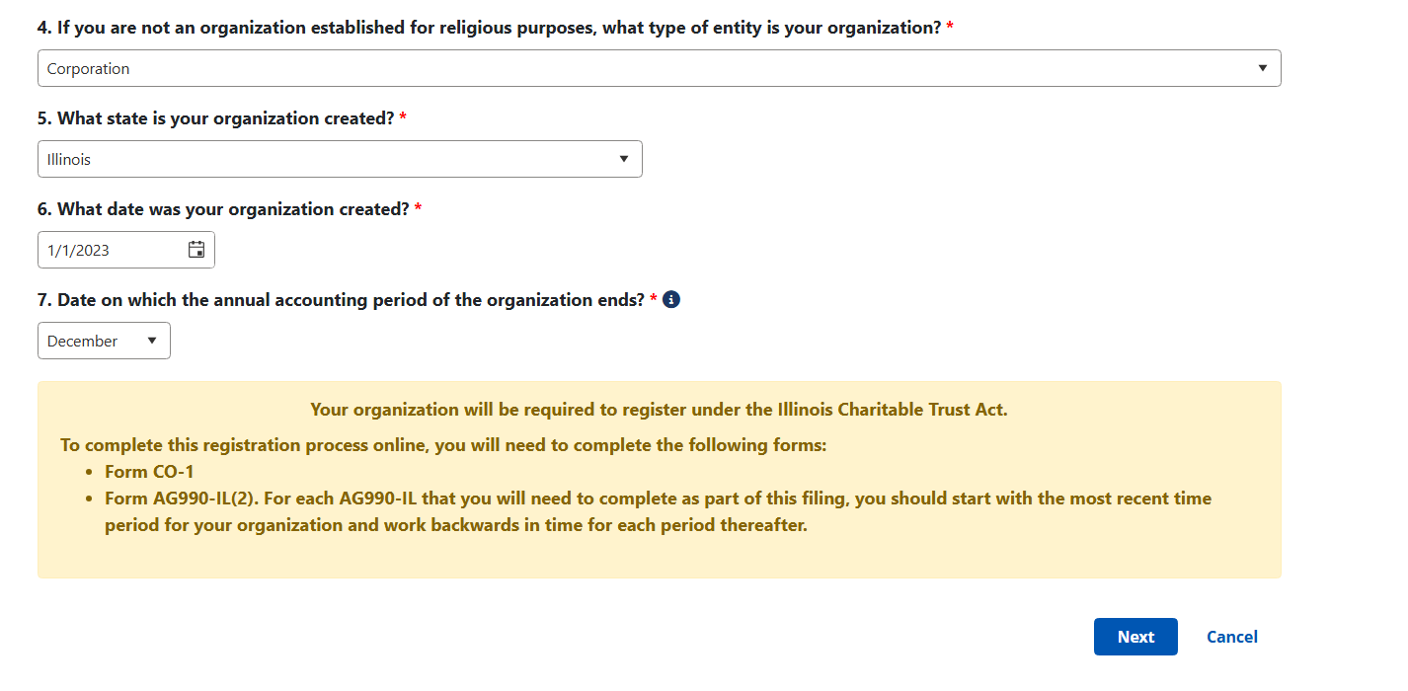

Slide 25
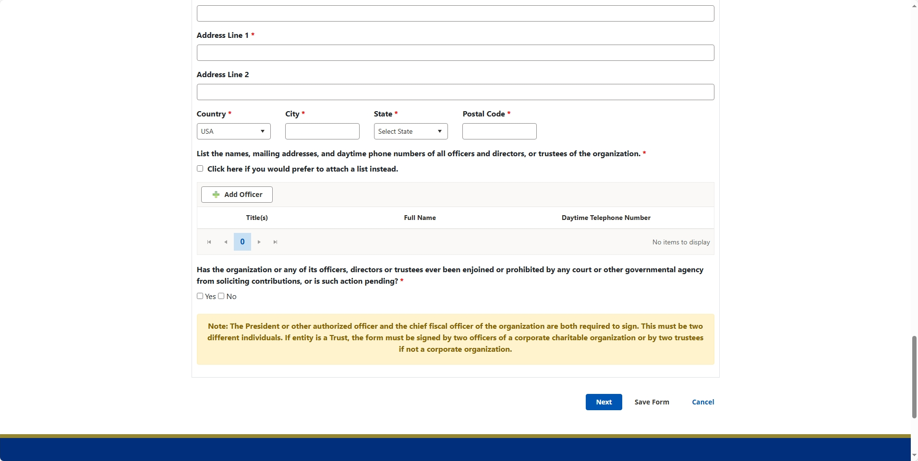

Slide 26
Filing an Annual Report (AG-990IL)

Slide 27
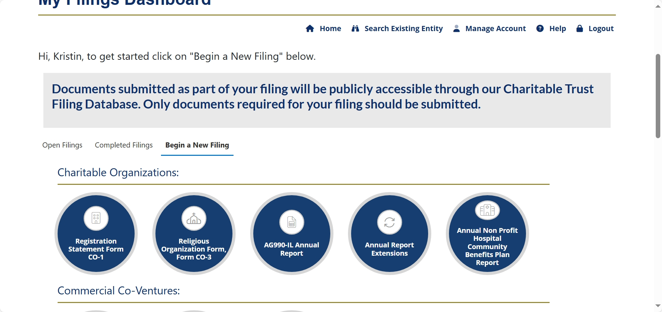

Slide 28
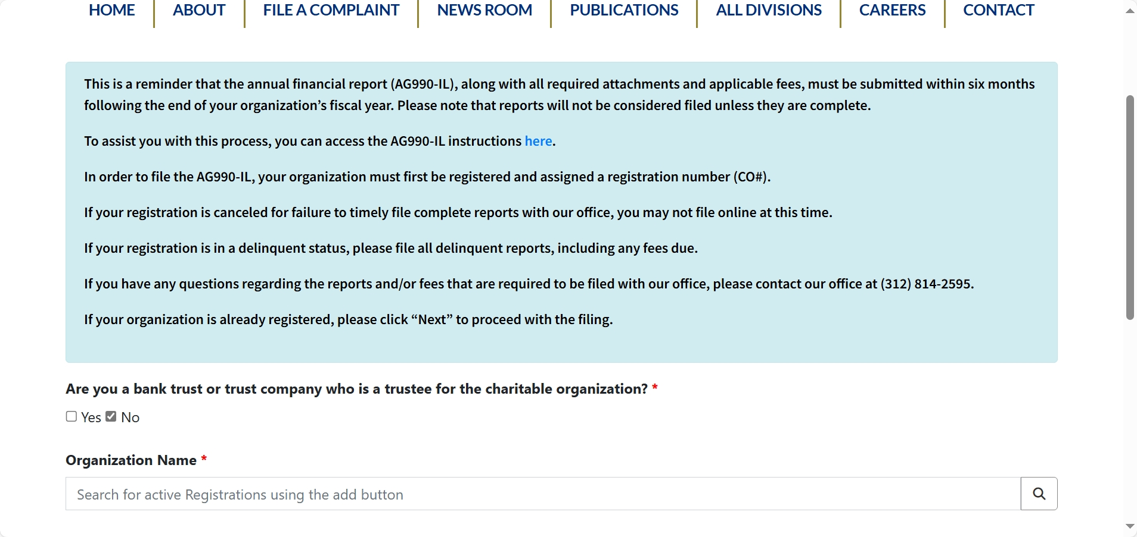

Slide 29
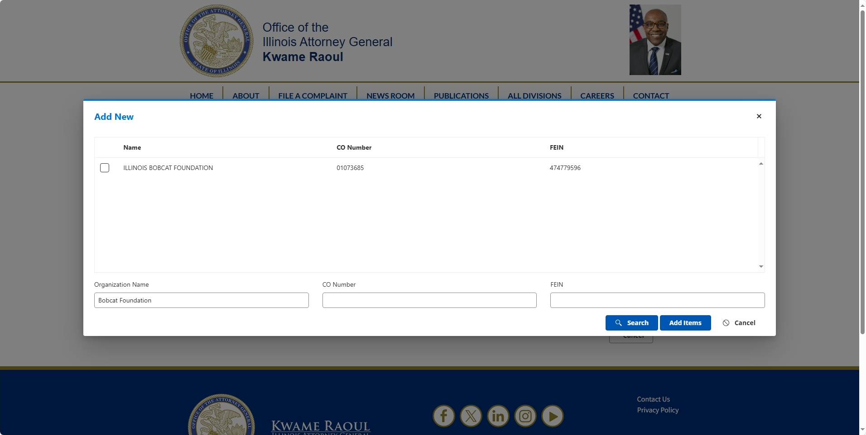




Slide 30
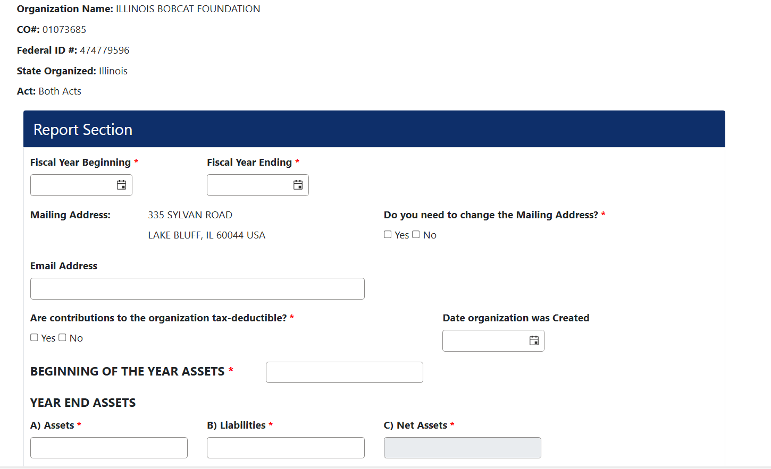

Slide 31
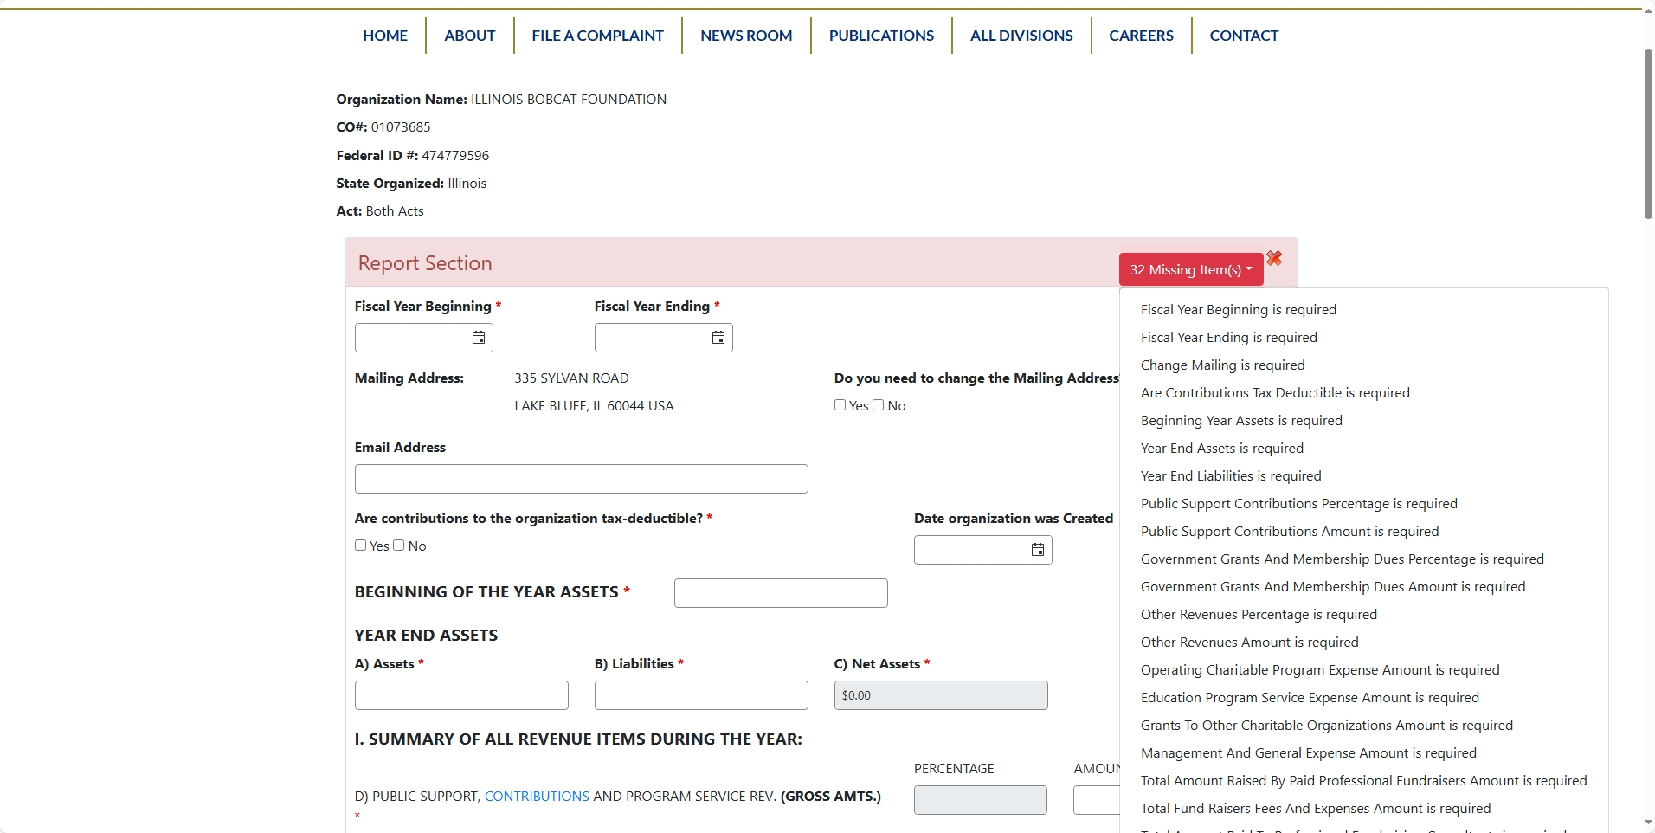

Slide 32
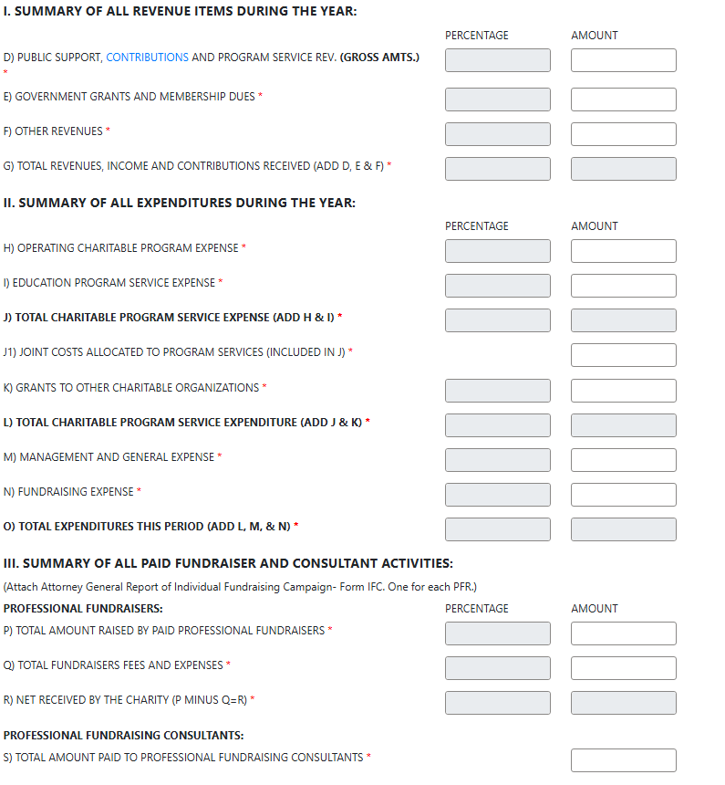
Based on the answers to these questions, you may be required to submit audited financials or reviewed financial statements. The system will prompt you to upload these documents.

Slide 33
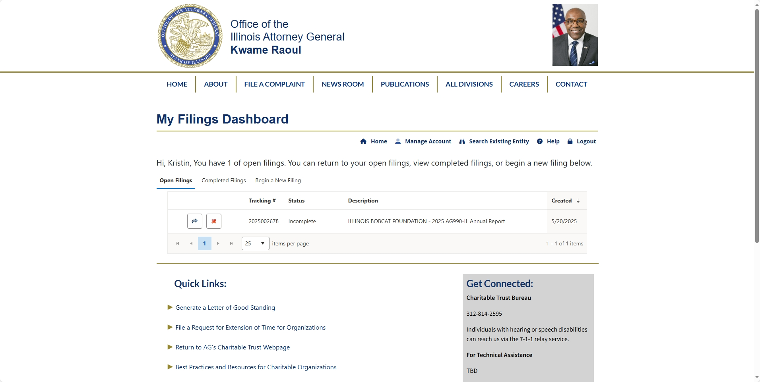



Slide 34
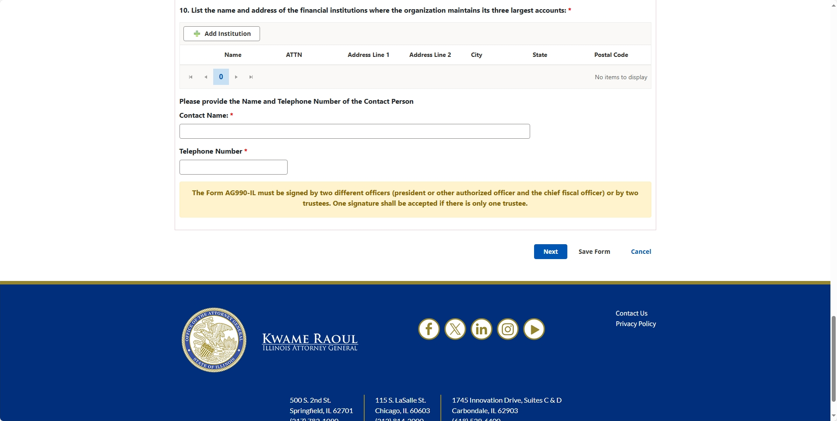

Slide 35
Sign those Forms!
Once all forms have been completed and attachments uploaded, system will guide user through signature process
All signatures must be obtained before filing can be submitted
Each form that requires attestation will have its own electronic signature process
Each form requiring a signature will have data fields for the user to enter email addresses for the person(s) who sign the form under penalty of perjury
If two signatures are required on the form, each person will receive his or her own email to complete this process.
Signer will be able to view documents and attachments before signing. The signer will click “Sign” after selecting the appropriate “Title” and entering his or her full name.
The user who input the email addresses will receive notices when the signer signs each time through email or by checking on the My Filings grid when the user is logged into the public portal.
The system will track the signature status for each signer. The user will be able to track the status of receipt of the signatures and resend the emails if necessary.

Slide 36
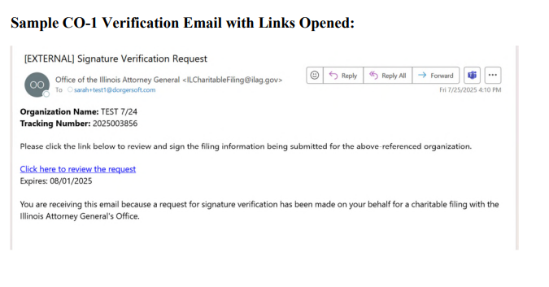
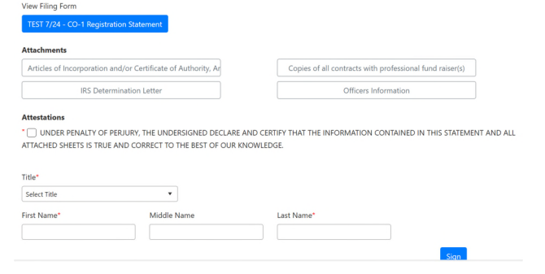

Slide 37
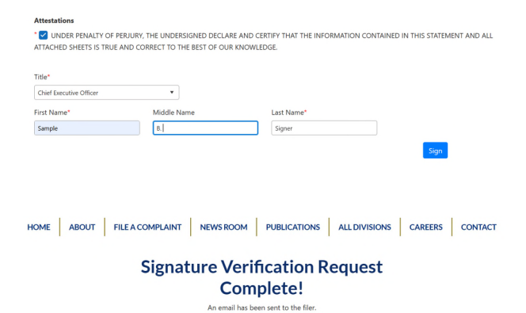
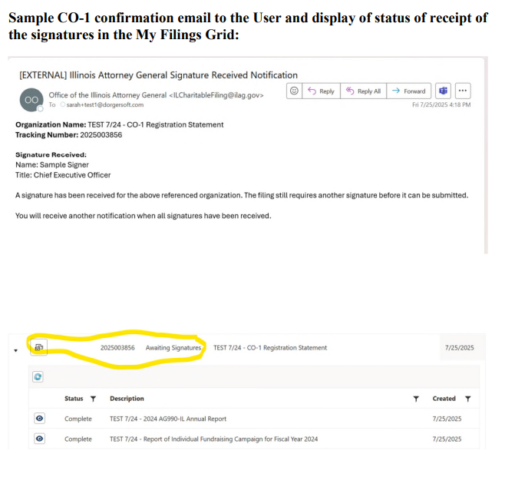

Slide 38
Proceed to Payment!
Once all signatures are received for all forms, the user will receive an email notice that ALL signatures have been received, and the status of the filing requires payment.
Once all signatures are received, the user will also see the status change to “Pending Payment” in the “My Filings” Grid
Fees are automatically calculated based on filing type, registration type, annual revenue or asset thresholds, late fees and/or registration fees
A fee summary will be displayed with the total due per form and a line-item breakdown
To proceed with Payment, click on the $ Icon, where the user will have the option to pay online or to mail in payment
If the user chooses to pay online, he or she will enter the payment information and click “Review Payment” to proceed and follow the prompts to complete the payment:
If the user chooses to mail in payment, the user must print the Voucher provided and include it with the check when mailing it to the Illinois Attorney General’s Office. Your filing will remain in “Pending Payment” status until the check is received and processed. Mail in your payment promptly to ensure your filing is processed on time. The filing will be considered late inf prompt payment is not sent in by the deadline. If payment is not received within 30 days, the submission is voided.

Slide 39
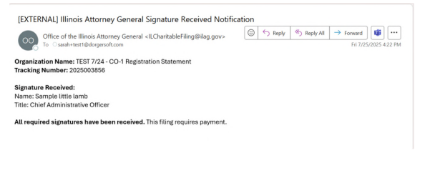
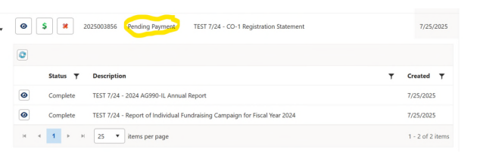

Slide 40
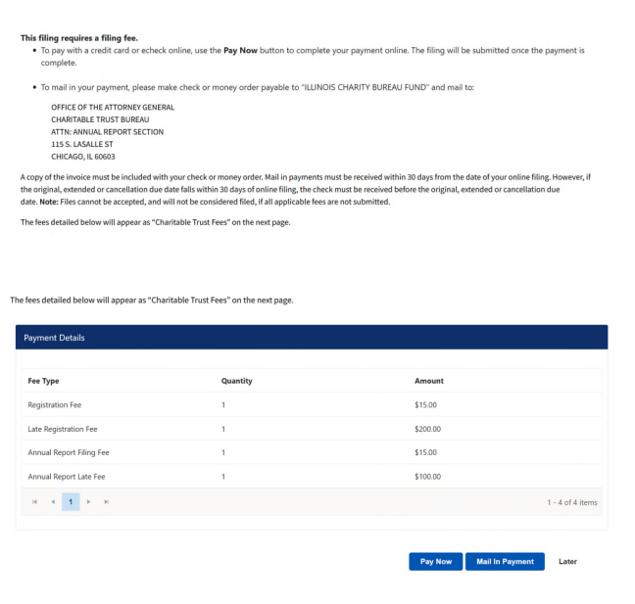

Slide 41
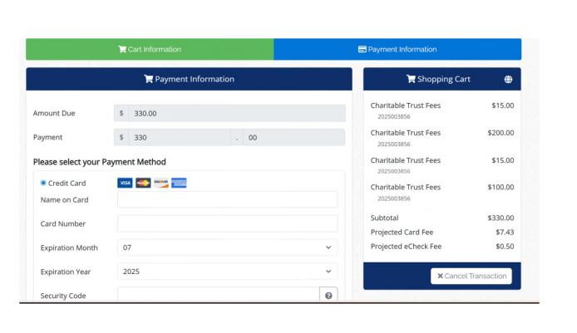
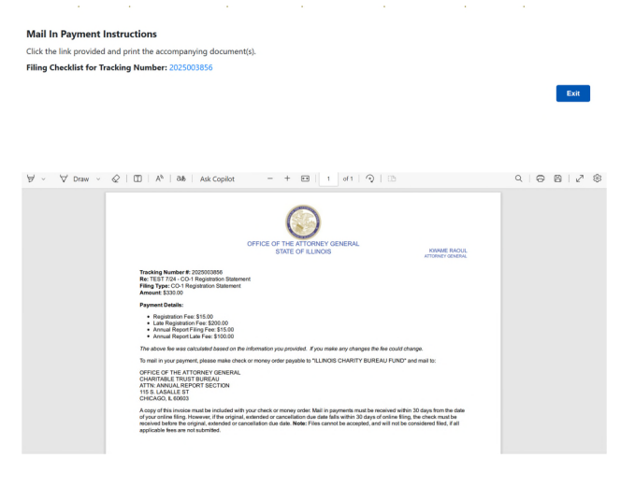

Slide 42
What’s Next?

Slide 43

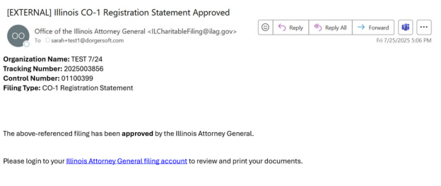
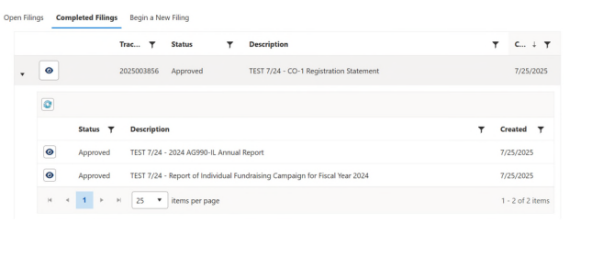
Approval!
If we accept the filing, the user will receive an email indicating a successful submission.
Also, the status of the filing will change on the My Filings Grid, where the filing will move from the Open Filings tab to the Completed Tab with the status of “Approved,” where the user can log in to print or save all the items submitted and approved.

Slide 44

Rejection
If the filing requires further submission of documents, the user will receive an email communication advising of the need for further information. The user can use the public portal to receive such further documents back to the Charities Bureau. Assuming the second submission satisfies the review, the filing will be approved.
If the filing cannot be approved, and it must be rejected, the user will also receive notice by email that such has been rejected, and the user will have to begin a new filing altogether to correct the deficiencies noted.
Track the status and outcome of our review in the “My Filings Grid”

Slide 45
Requesting an Extension of Time

Slide 47
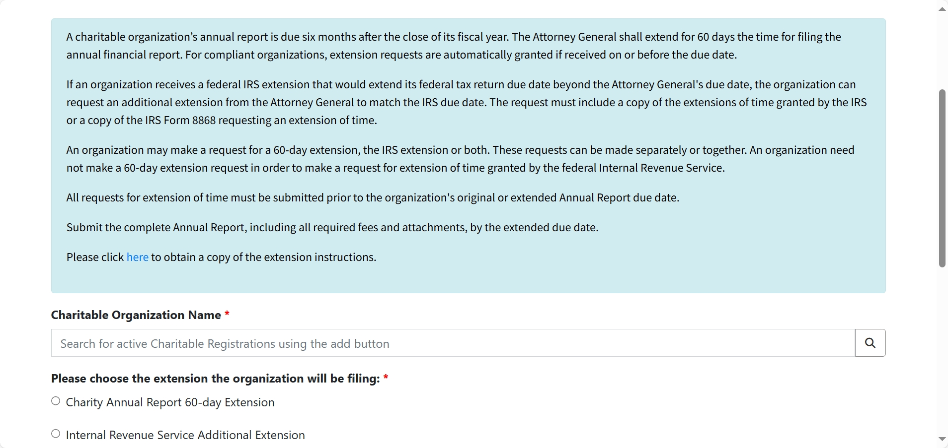

Slide 48
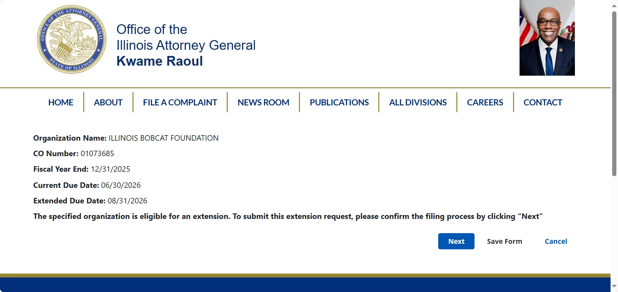

Slide 49
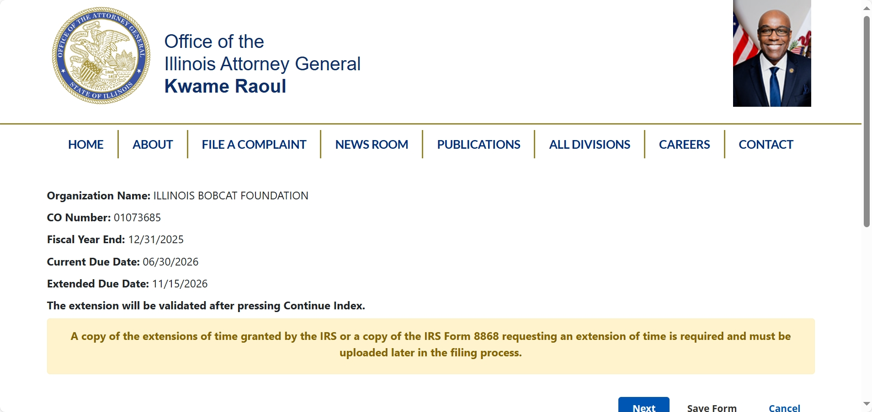

Slide 50
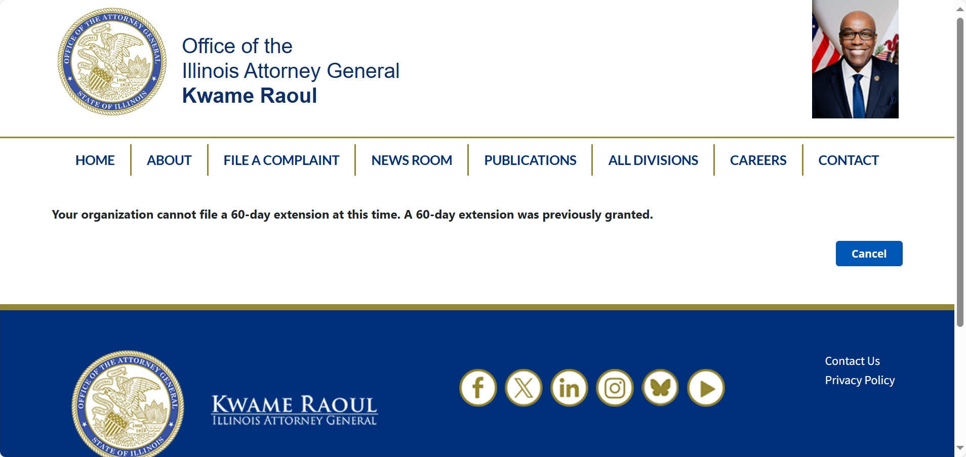

Slide 51
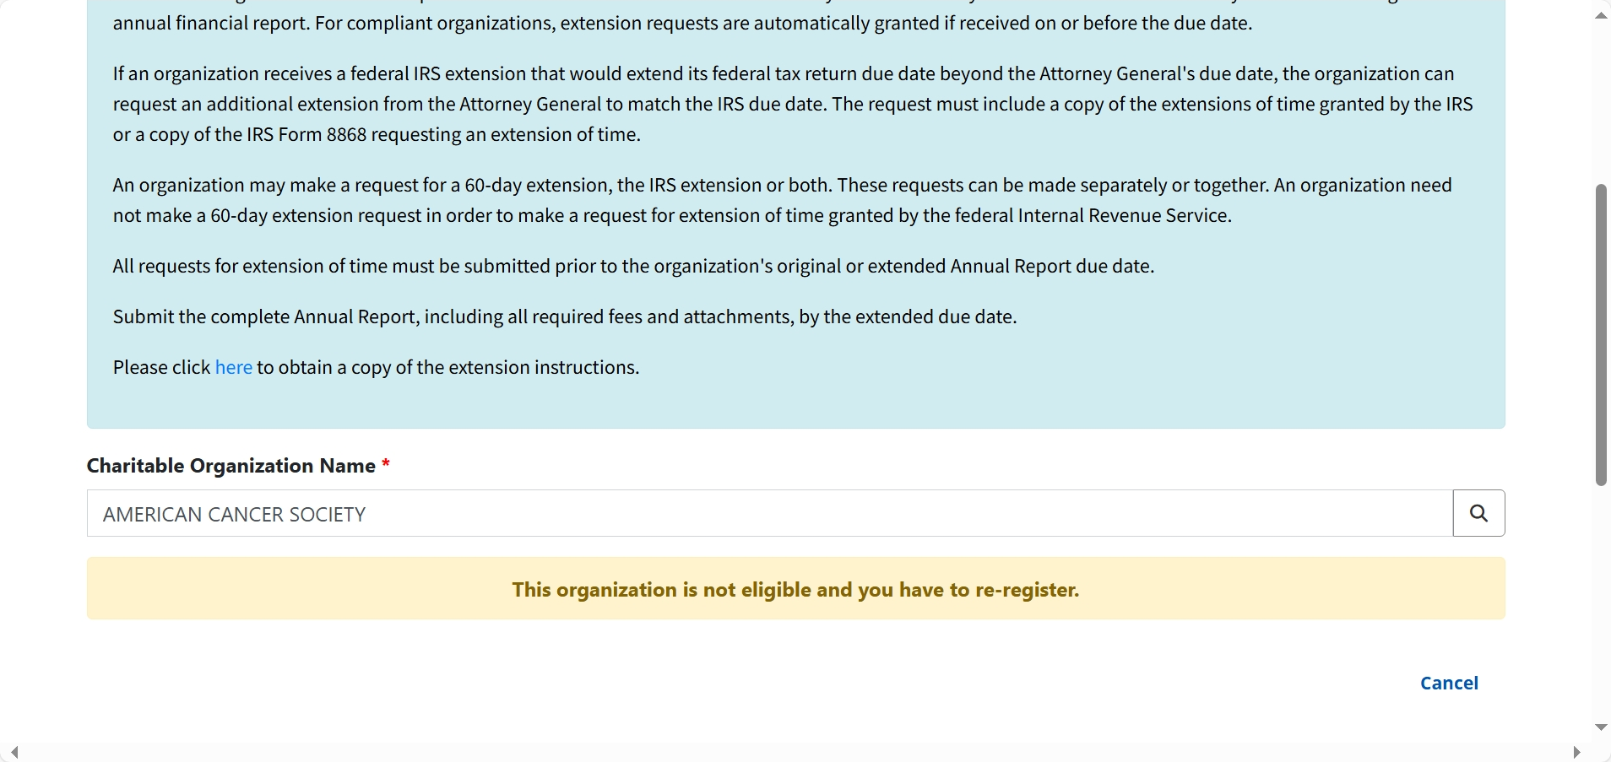

Slide 52
Letter of Good Standing

Slide 53
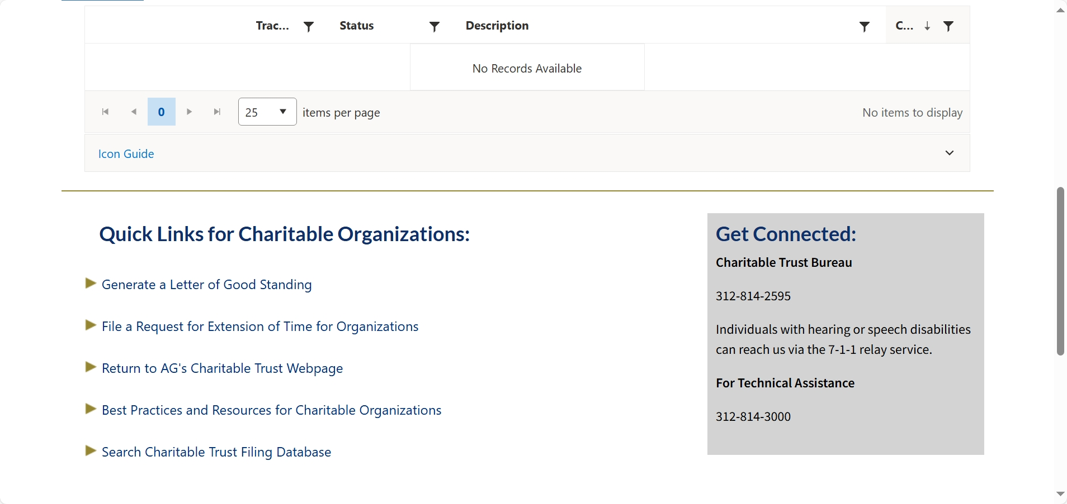

Slide 54
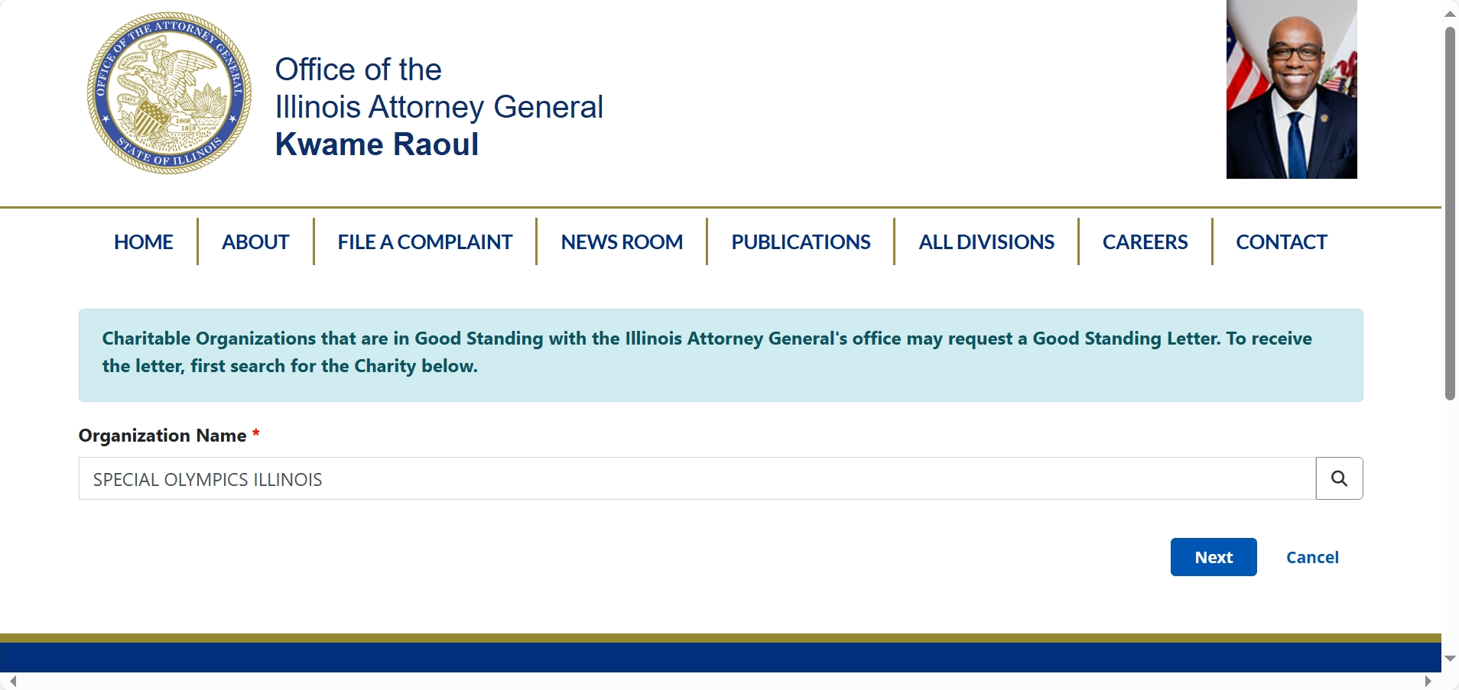

Slide 55
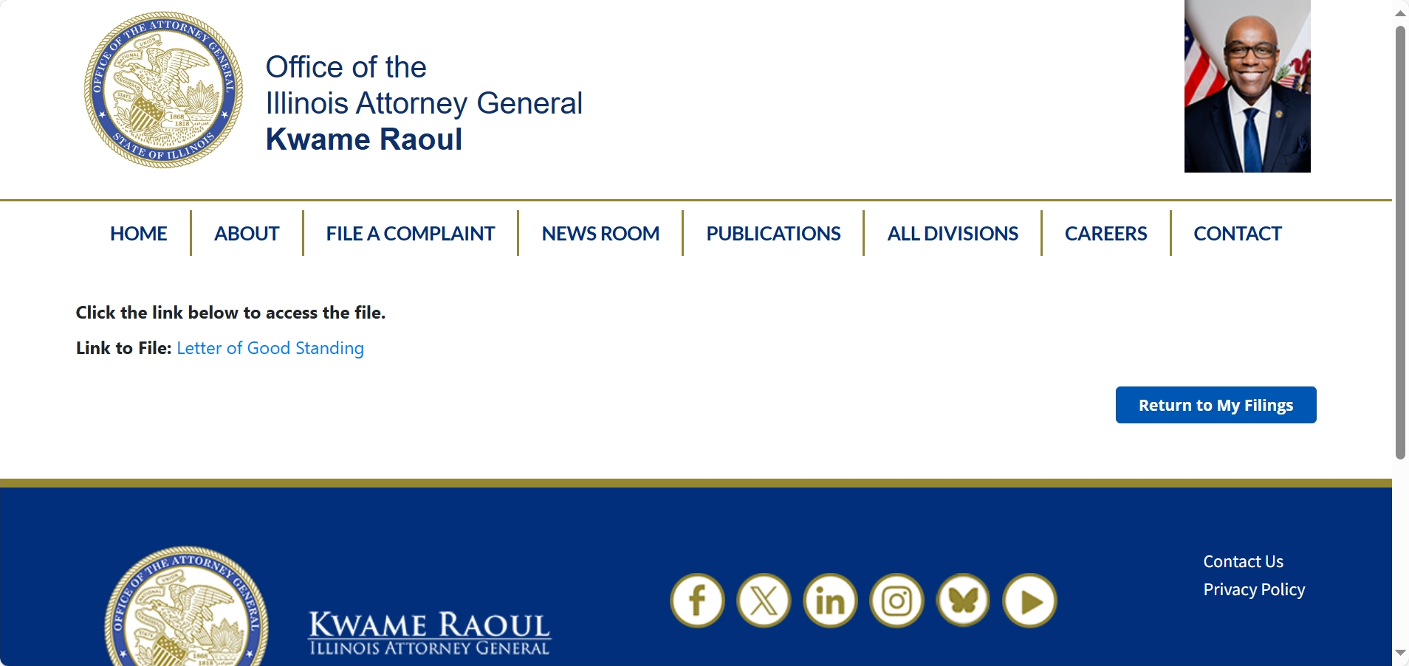

Slide 56
Searching the new Charitable Database

Slide 57
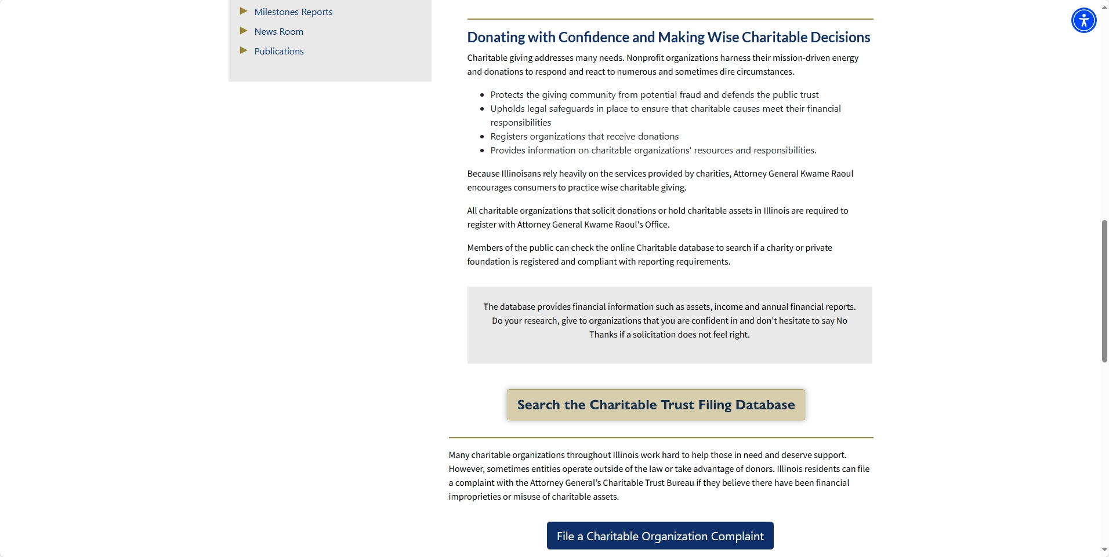

Slide 58
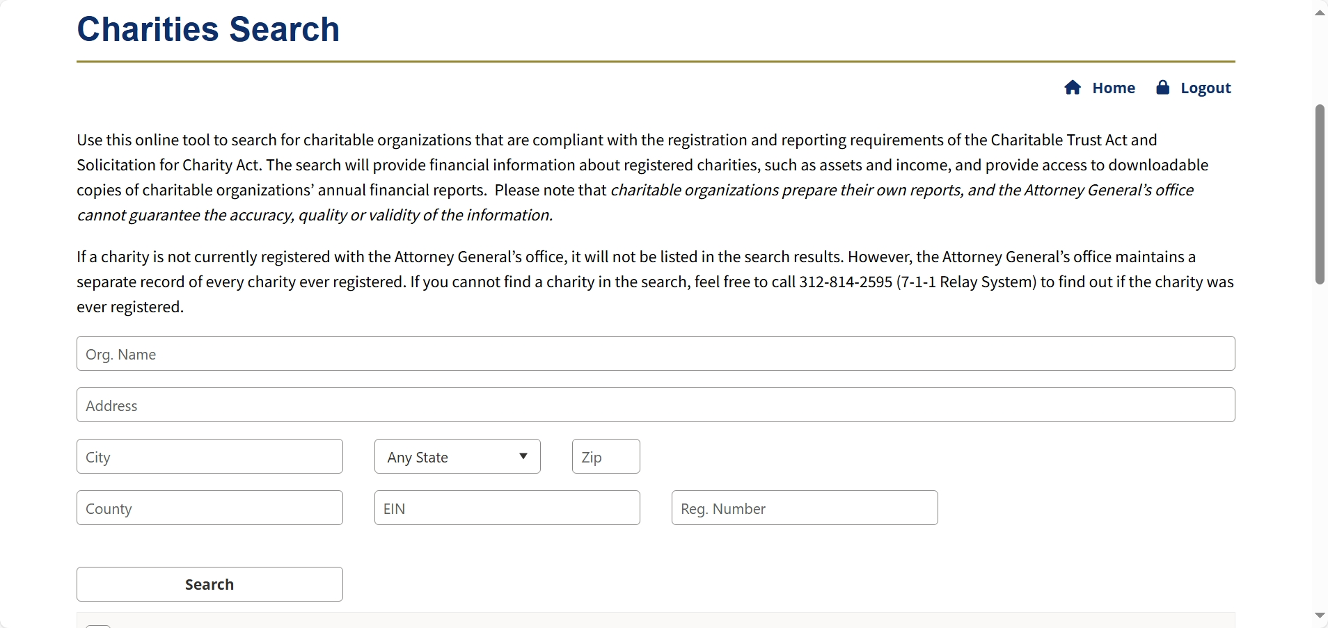

Slide 59
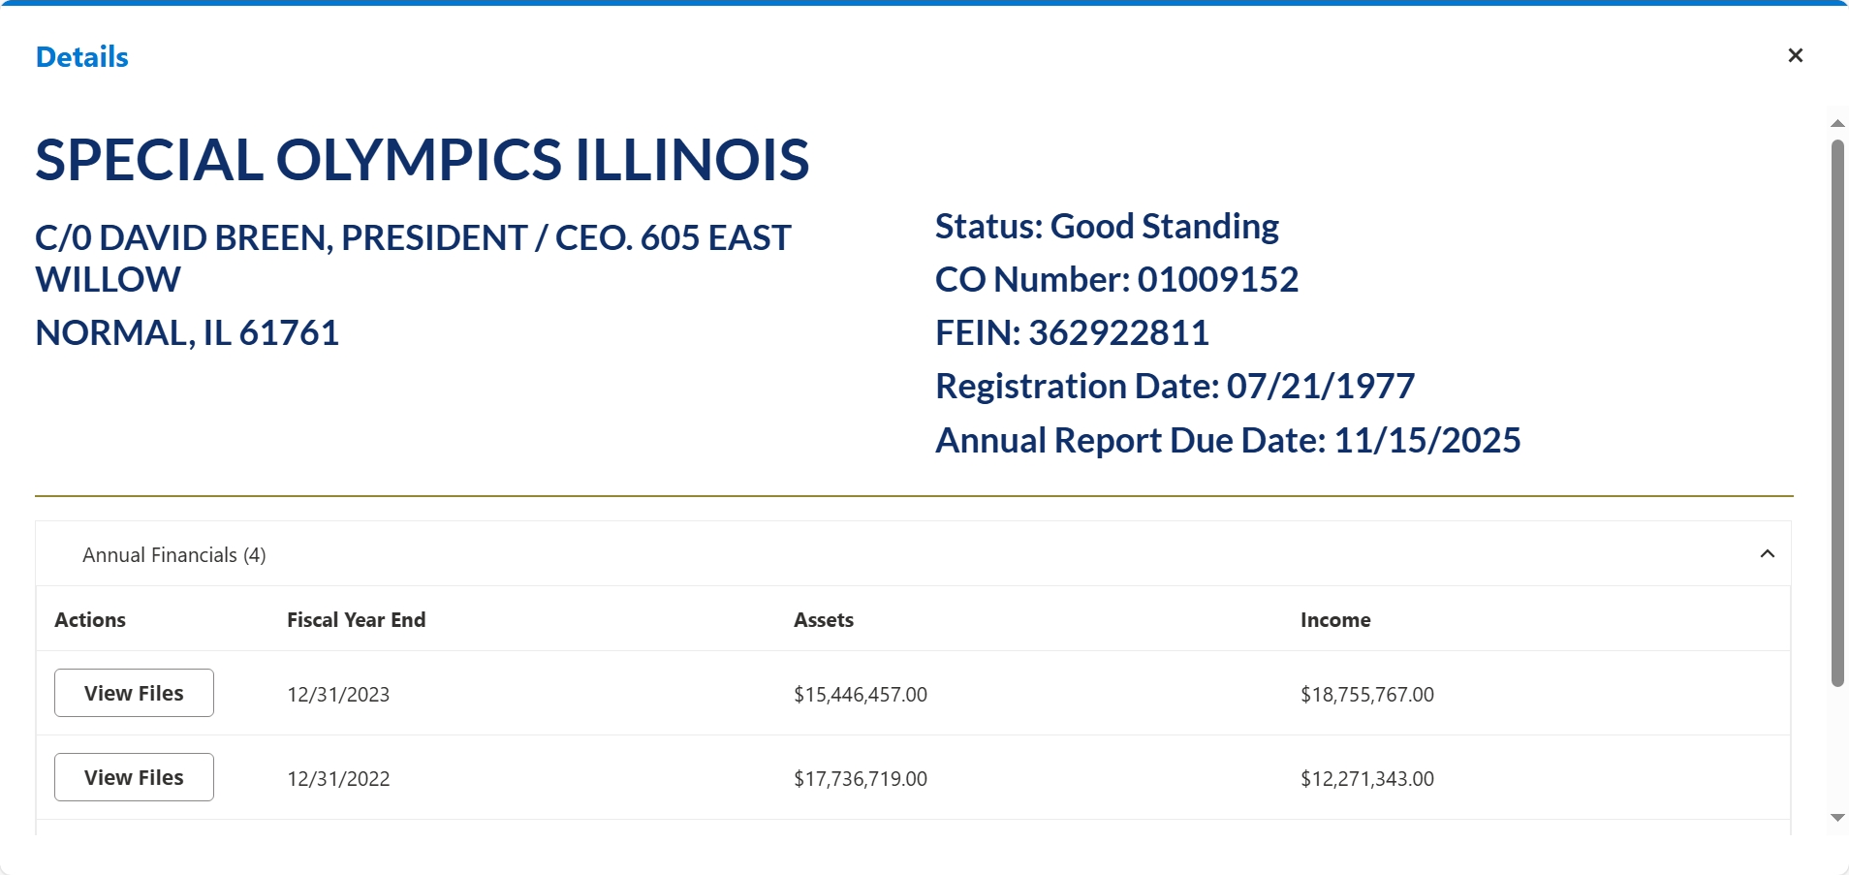

Slide 60
Progress So Far:
2,740 active portal users as December 8, 2025
Acceptance rate for Online Filings: 87.72%
  Over 4,700 online filings to date
  Common rejection reasons: attachments, wrong boxes checked, technical difficulties, easily corrected
  Most online filings processed same day or within few days
Acceptance rate for Paper Filings: 74.55 %
  Over 7700 paper filings processed to date
  Common issue: incompleteness
  Still processing paper reports received at 6/30/2025 deadline
  Farther along than we usually are thanks to online filing system

Slide 61
Contact the Charitable Trust Bureau with any questions!
Illinois Attorney General
Charitable Trust Bureau
115 S. LaSalle St.
Chicago, IL 60603
(312) 814-2595
TTY: 1-800-964-3013

